Slide 1
WORKFLOW TO CURATE AND DESSIMATE FLOODING RELATED DATA PRODUCTS AND IMPACT ASSESSMENT TO USERS USING GOOGLE EARTH ENGINE
Submitted by:
Vivek Kumar M. Tech (GID)
Nalin Sharma M. Tech (GID)
Yamini Agrawal M. Tech (PRSD)
Ashutosh Pande M. Tech (PRSD)
Submitted to:
Mr. Shiva Reddy
GID, IIRS

Slide 2
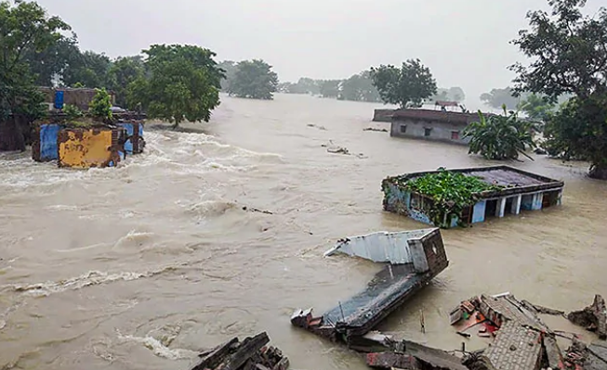
INTRODUCTION
Floods in Bihar are common
Samastipur experiences heavy floods every year
Heavy rainfalls and overflowing rivers causes floods
SAR is an effective way to map as it penetrates thick clouds
Mapping the damage assessment of human resources and livelihood
Figure 1: Patna Bihar Flood
Source:https://www.ndtv.com/india-news/bihar-flood-situation-worsens-75-lakh-in-16-districts-affected-2277975

Slide 3
OBJECTIVES
1) Mapping of flood inundation area Using SAR.
2) Quantifying the impact of flood on agricultural and built-up areas.
i) Creation of LULC map for Samastipur.
ii) Integration of LULC classes with Flood Map.

Slide 4
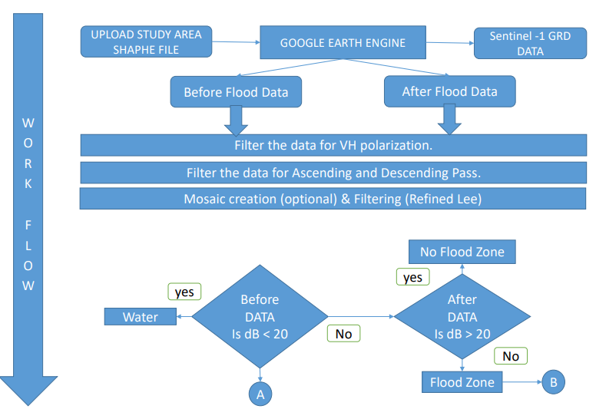

Slide 5
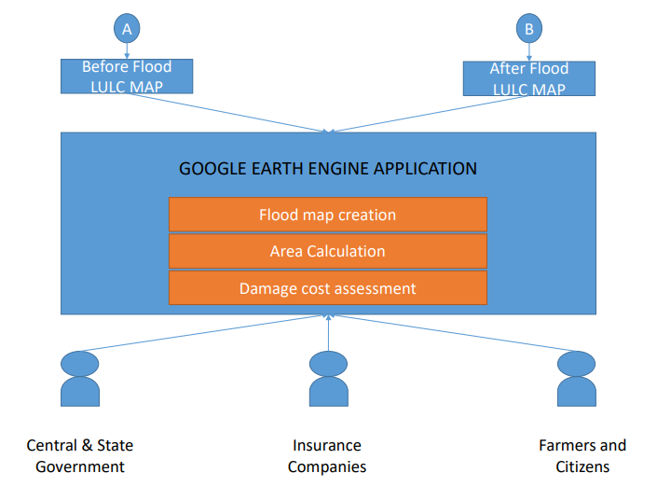

Slide 6
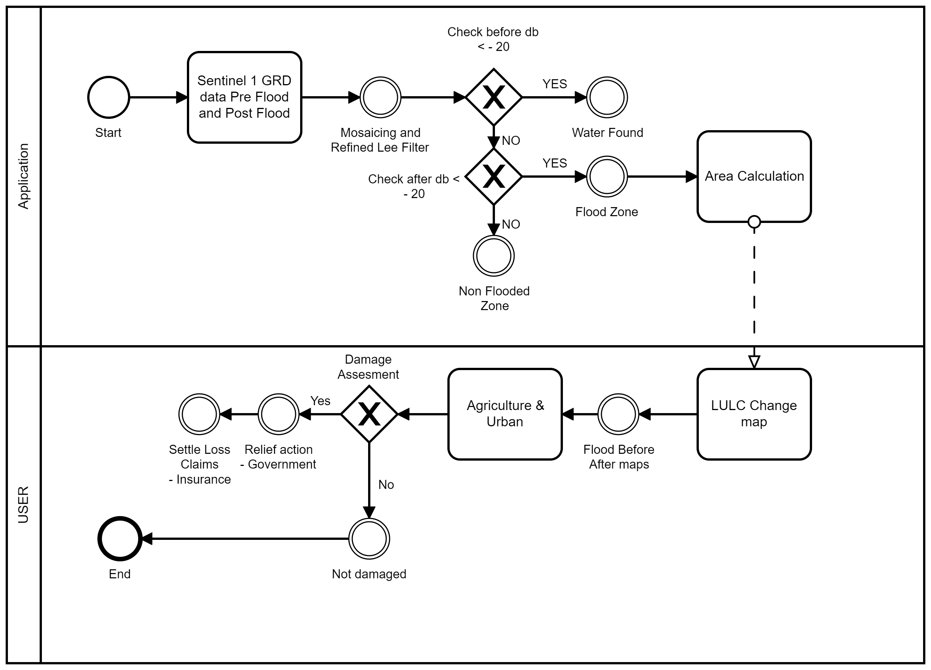
BPMN

Slide 7
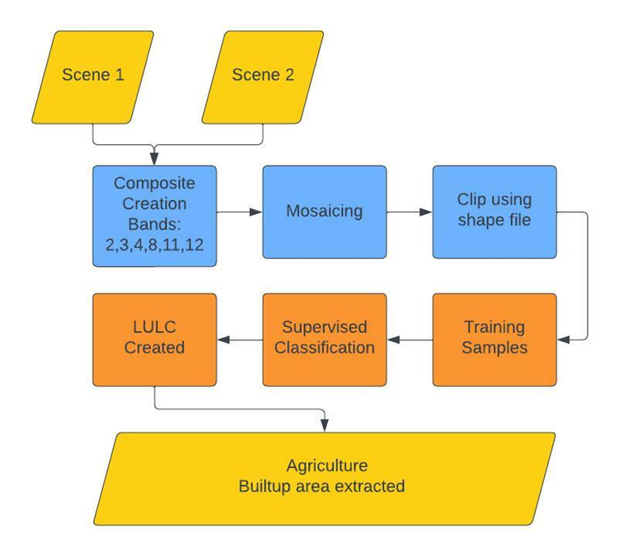
Fig 4: Process Diagram for LULC

Slide 8
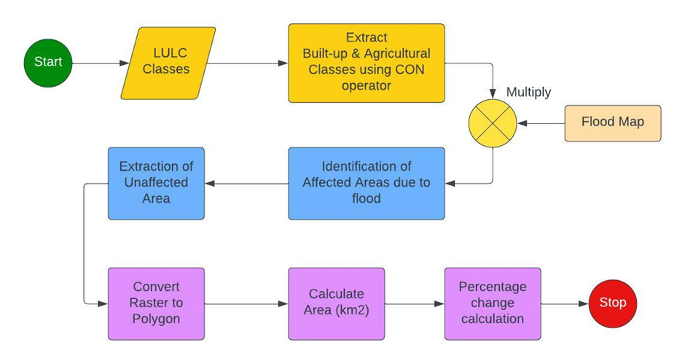
Fig 5: Process Diagram for quantification of affected regions

Slide 9
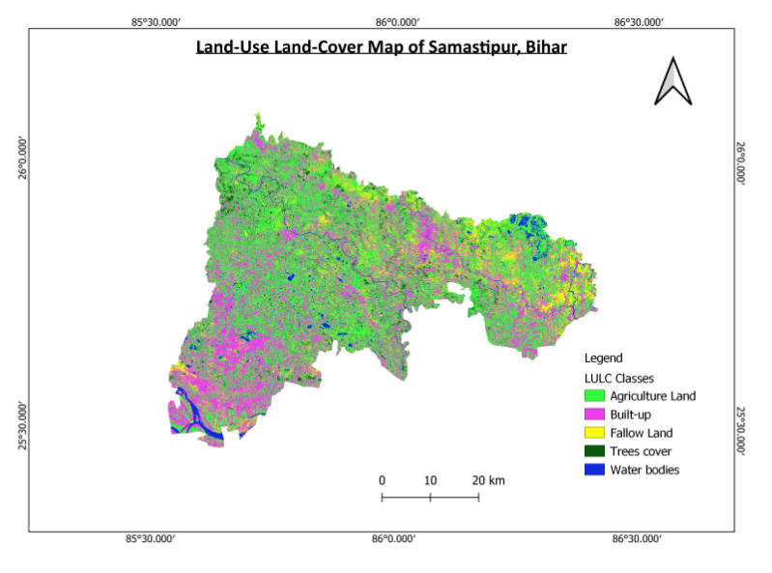
RESULTS

Slide 10
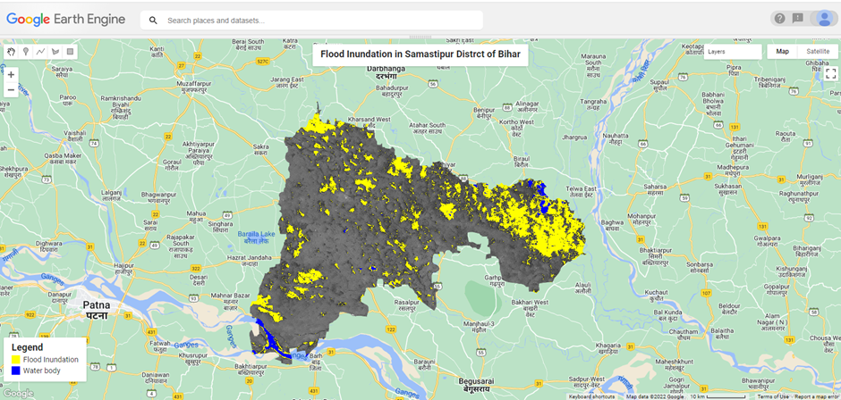
LINK TO CODE: https://code.earthengine.google.com/698988d16320094eacf2e8e87d33ee6f

Slide 11
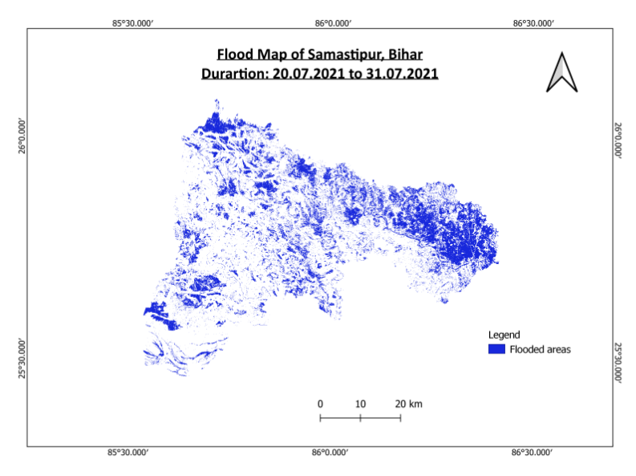

Slide 14
DAMAGE ASSESSMENT AND QUANTIFICATION
Class | Pre-flood area (in km2) | Post-flood area (in km2) | Percentage Change (%)
Agricultural fields | 1357.68 | 1045.164 | 23.0183
Built-up areas | 988.399 | 758.422 | 23.267

Slide 15
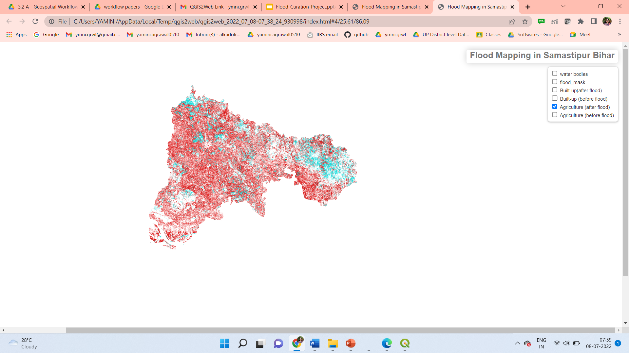

Slide 16
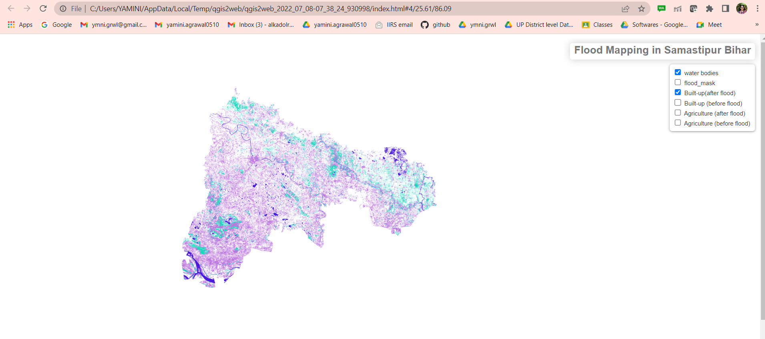

Slide 17
BIBLIOGRAPHY
Ahmad, F., Uddin, M. M., & Goparaju, L. (2018). Assessment of remote sensing and GIS application in identification of land suitability for agroforestry: A case study of Samastipur, Bihar, India. Contemporary Trends in Geoscience, 7(2), 214- 227. https://doi.org/10.2478/ctg-2018-0015
Duarte, L., Queirós, C., & Teodoro, A. C. (2021). Comparative analysis of QGIS plugins for web maps creation. La Granja, 34(2), 8-26. https://doi.org/10.17163/lgr.n34.2021.01
Grimaldi, S., Xu, J., Li, Y., Pauwels, V., & Walker, J. (2020). Flood mapping under vegetation using single SAR acquisitions. Remote Sensing of Environment, 237, 111582. https://doi.org/10.1016/j.rse.2019.111582
Manavalan, R. (2016). SAR image analysis techniques for flood area mapping - literature survey. Earth Science Informatics, 10(1), 1-14. https://doi.org/10.1007/s12145-016- 0274-2

Slide 18
THANK YOU

